Slide 1

Combining data set discussion
Dea Putri

Slide 2
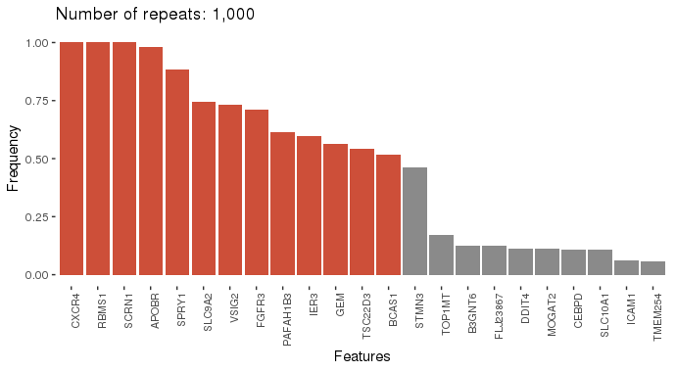
Microarray selected
Number of features: 9,695
Feature selection was done using lasso (glmnet R package) over 1,000 repeats

Slide 3
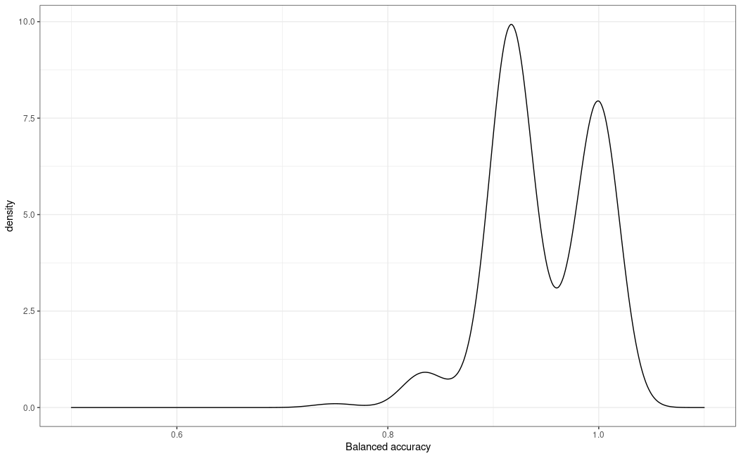
Balanced error rate accuracy
1000 CV
Penalized microbiome data, not penalizing the microarray data
Median | 0.91
SD | 0.05

Slide 4
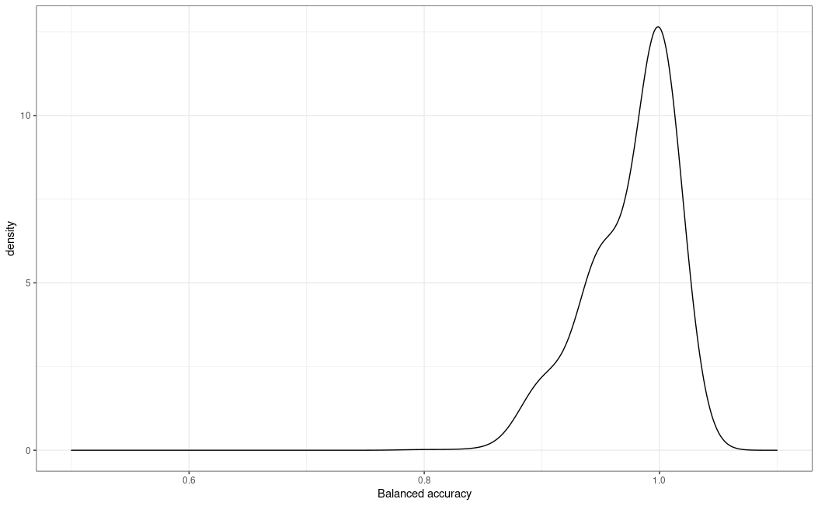
Balanced error rate accuracy
1000 CV
Penalized permutated microbiome data, non-penalizing microarray data
Median | 1
SD | 0.0341

Slide 5
Microbiome selected
None, out of 1000 CV
Next step?

